Slide 1
Code-A-Thon 2016 DisplayBTeam
Chris Meyers
William Reeder
Robert Reeder
Ryne Wolfgang

Slide 2
ArTech Search and Rescue
Mission Statement:
Our goal was to create a planning and decision aid application for search rescue. This application is based on the NASA Worldwind SDK.

Slide 3
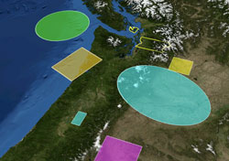
What is Worldwind?
World Wind is a free, open source API developed by NASA that provides a virtual globe. It allows developers to quickly and easily create interactive visualizations of 3D globe, map and geographical information.
Organizations across the world use World Wind to monitor weather patterns, visualize cities and terrain, track the movement of planes, vehicles and ships, analyze geospatial data, and educate people about the Earth.

Slide 4
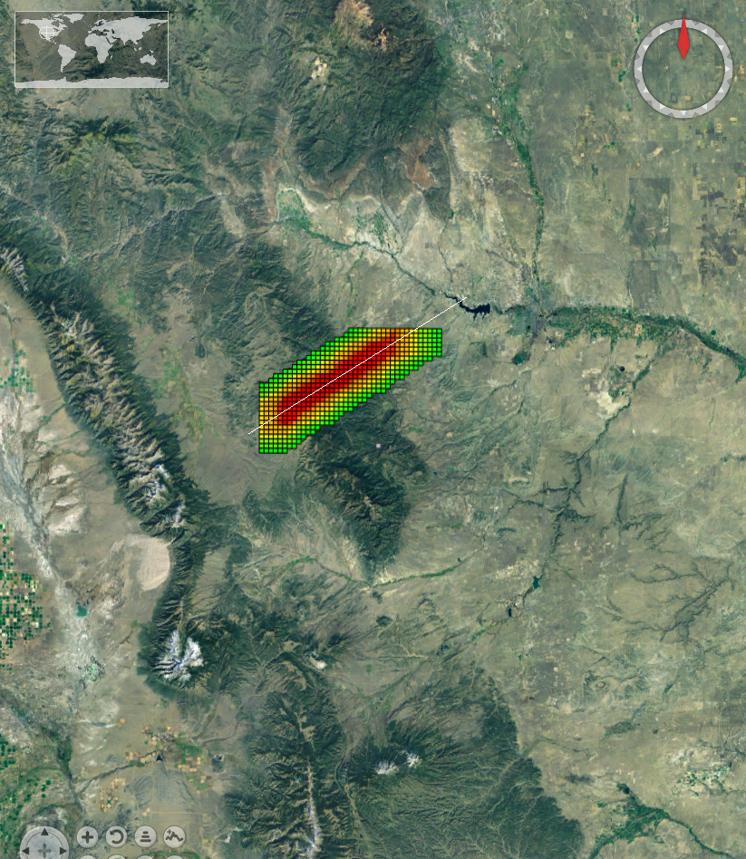
What does the application do?
The search area is based on the last known location of a hiker and the path he/she was traveling.
In this case a simple path shows the heat map with probable locations to plan a search.
Red is the most likely locations and green the least likely.

Slide 5
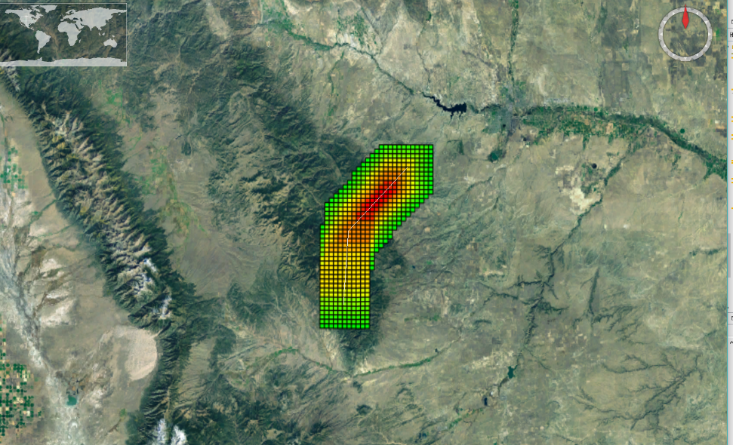
How are the areas calculated?
The search area is based on the last known position and average movement speed for a human. Olympians may require a larger search area!
Weighted averages for the normal distributions have been used to calculate the probable areas for a search.

Slide 6
What does the application do?
The search area is based on the last known position and average movement speed for a human. Olympians may require a larger search area!
Weighted averages for the normal distributions have been used to calculate the probable areas for a search.

